Slide 1
Electrical Induction Based on Andre Ampère’s Law Toward Einsteinian Electrodynamics
By James Keele, M.S.E.E.
September 26, 2022
Notes:
Notes:
1. Examined for formula accuracy 10/7/22. JK

Slide 2
Introduction
1st Presentation of this series outlines the mathematical derivation of the old Andre Ampère’s Law using SRT.
2nd Presentation shows with experiment the old Andre Ampère’s Law is valid and use of current element lengths based on wire diameter expedites computer calculations using the Law.
This presentation shows that while Andre Ampère’s Law allows one to calculate force between current elements having constant current, it may be mathematically differentiated and used to calculate induction effects having varying currents thru the current elements
The old Andre Ampère’s Law:

Slide 3
Introduction Cont’d
Theory for induction was developed in the author’s paper on Einsteinian Electrodynamics.
Lorentz Force Law is replaced with a new similar law for force between relatively slow moving isolated charges:

Slide 4
Introduction Cont’d

Slide 5
Induction by Two different ways:
Induction by movement:
Move a charge, wire or current element in a magnetic field.
A voltage (emf) is acquired by the charge or is induced along the wire or
current element.
2. Induction by changing magnetic field:
Vary the magnetic field created by a current in a wire or current element.
A voltage or emf is induced on the separated charge, wire or current element.

Slide 6
Definition of the “Volt”
It is helpful to recall the definition of voltage from a physics book: “It is the work W done by a unit charge in passing between two points of a circuit equal to the potential drop between these two points. If W is now taken to represent the work done by the charge Q in moving between two such points, the potential drop betweenthe points is
The term potential difference applies to both emf and potential drop; the practical unit is the volt. The potential difference between two points is one volt if a charge of one coulomb either requires or expends one joule of energy in moving from one point to the other” .

Slide 7
Basic Considerations
The charges, , can either be an isolated charge like an electron or proton, or they can be a collection of single polarity charges like the conducting electrons in a current element of finite length ds.
While the energy that establishes the induced voltage is created by the relationship of two entities, like an electron and a current element, the induced voltage will be considered to be on just on of the entities, like the current element. I will call this entity a “receptor”.
In the calculations, for instance, for the induced voltage in a current element, the energy W in the formula is the induced voltage V in the current element.
To get the total voltage in a wire, for instance, The induced voltages in all the current elements of the wire must be added.

Slide 8
Induction Cases Considered
Induction by movement of a charge with respect to a stationary current element.
Induction on a stationary charge with respect to a stationary current element by varying current in the current element.
Induction between a stationary current element and a moving current element.
Induction between two stationary current elements with varying current in one element.

Slide 9
1. Induction by movement of a charge with respect to a stationary current element
. Let u₂ be the vector velocity of q₂ and u₁ be the vector velocity of the electron lattice in the current element. Then
and v is the magnitude of this
relative velocity.
β is the angle between v and r₁₂.
So the induced voltage will be:
where

Slide 10
2. Induction on a stationary charge with respect to a stationary current element by varying current in the current element.
This is the situation where a changing magnetic field induces a voltage on the stationary charge with the distance between the current element and the charge remaining constant. The energy stored in the field between the current element and charge is given by:

Slide 11
2. Induction on a stationary charge with respect to a stationary current element by varying current in the current element cont’d.

Slide 12
3. Induction between a stationary current element and a moving current element
Let be the velocity vector of
:

Slide 13
4. Induction between two stationary current elements with varying current in one element
In this case we integrate
Andre Ampère’s Law
from infinity to r to get the energy
in the field between the two current elements and then vary the current in one of the current elements to vary the field energy. The change in field energy then induces a voltage in the other current element. These current elements can be in the same circuit or in separate circuits.

Slide 14
Definition of inductance between two current elements

Slide 15
Mutual Inductance
Self Inductance

Slide 16
Self induced voltage
Voltage induced in Coil(2) due to varying current in Coil(1)
(Used in experiment)

Slide 17
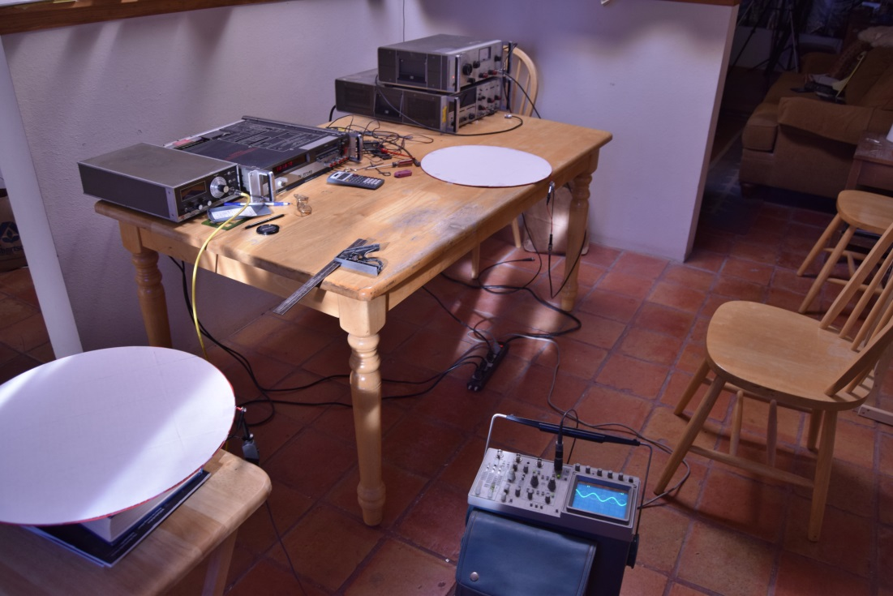
Experiment
Side-by-side distance test with two single-turn round coils

Slide 18
Experiment Cont’d
Lying flat in a plane and side-by-side the two single-turn coils were separated by a measured distance and induction between the two was tested. A 0.233 µF capacitor was connected in parallel with the primary coil. The applied sine-wave voltage resonated the circuit at a frequency of 269 kHz with amplitude of 8.02 v p-p. The induced largest voltages on the secondary coil were measured by the digital multi-meter and the smallest voltages were measured by the scope . Distances that were based on using the radius of the coils (.2016 m) as a unit of measure were set by a factor (fac), used in the computer program to calculate the induced voltage. The results of the test are shown in Table 1 below.

Slide 19
Experiment Cont’d
Table 1. Measured and Computed Induced Voltage in Secondary Coil in Side-by-Side Test.
(8.02 v p-p applied to primary coil)
Factor (fac) | Distance between centers m | Measured mv p-p | Computed (-)mv p-p
3.1 | 0.423 | 286 | 286
3.5 | 0.504 | 106 | 108
4.0 | 0.605 | 50.3 | 51.4
5.0 | 0.806 | 19.2 | 18.7
6.0 | 1.01 | 9.5 | 9.0
7.0 | 1.21 | 5.5 | 5.1
8.0 | 1.41 | 3.2 | 3.1
20 | 3.83 | ------ | 150µv p-p

Slide 20
Discussion of results of side-by-side Experiment
1. The induction formulas are supported.
2. This author finds it absolutely amazing that you can calculate the induced voltage accurately at large distances of coil separation.
3. While the author has not attempted to use the conventionally accepted force and induction formulas for calculation, it is expected that the attempt to do so would be very difficult. You would come up against violation of Newton’s Third Law and the problem of calculating flux linkages at large distances from the primary coil. It may be possible to do so, but has not been attempted by the present author.
4. The full significance of these results has not been fully realized by the author. He suspects it denotes something about the reality of the e-field, the magnetic field, relativity, space, and gravity.

Slide 21
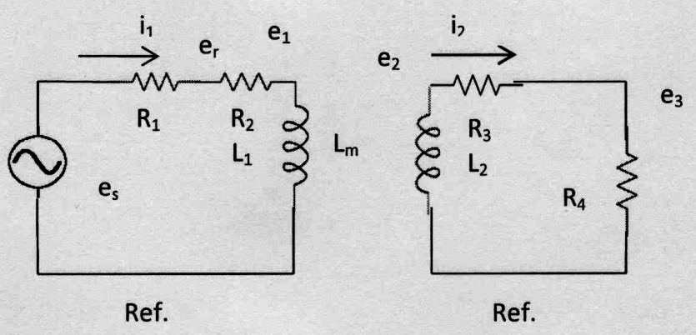
Figure 1. General circuit for testing mutual inductance with load in secondary circuit, R₄.

Slide 22
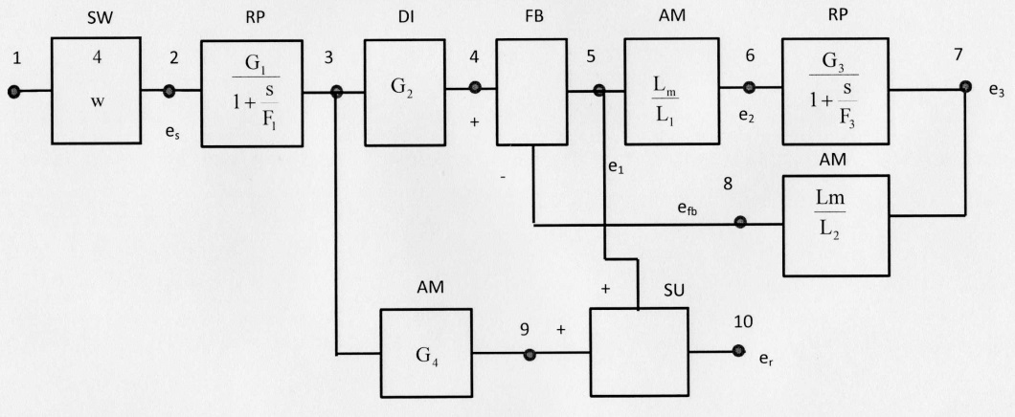
Figure 2. Block diagram for dynamic computer modeling of the circuit of Figure 1.

Slide 23
Conclusions
1. The induction formulas shown are correct. Its only limitation is that it applies to relative velocities of charges much lower than the speed of light. Other formulas may be developed for much higher relative velocities.
2. The new model of the magnetic field provides new insights in the force interactions of moving isolated charges and current elements. For example, the actual force between two coils may also be calculated.
3. It is absolutely astounding that one can accurately calculate the induced voltage on a secondary coil that is separated, say 3 meters, from the primary coil.

