Slide 1
Mathematical Derivation of Andre Ampère’s Law Using Special Relativity Theory
By James Keele, M.S.E.E.
April 21, 2021
# 1 Presentation
Notes:
Notes:
1. Checked for formula updates 10/10/22. JK

Slide 2
Introduction
The Andre Ampère’s Law is a mathematical equation that describes the force between two current carrying wires. It was created by Ampère from a series of experiments in about 1822. Ampère was a French physicist and mathematician. I am employing Andre’s first name because I need to distinguish his law from other laws that are also called Ampère’s Law. For example: Ampère’s Law in Maxwell’s Equations.
I think this presentation is important just to get the field of Electrodynamics back on a better track than the one developed by Maxwell and Faraday back in the mid 19th century. Also, because the old law can be derived mathematically from Special Relativity, then Special Relativity supports the old law, and the old law supports Special Relativity. Andre Ampère determined his law from a set of very careful experiments and was highly praised later by James Clerk Maxwell.
Several other physicists have written similar laws. They are Weber, Grassman, Maxwell, Neumann,, etc. The laws that Maxwell and Grasmann have written are popular ones in the current physics literature. Weber’s law is very similar to Andre Ampère’s Law, and as such deserves a lot of credit. It is currently promoted by Assis of Brazil.

Slide 3
Introduction Cont’d
Maxwell and Faraday invented the concept of a magnetic field currently taught in today’s colleges. Special Relativity shows an entirely different way to view the magnetic field. Andre Ampère determined his law about 200 years ago. About 100 years later Einstein developed Special Relativity. And in about another 100 years I am showing this connection between Andre Ampère’s Law and Special Relativity.
This Power Point presentation provides an outline of the mathematical derivation. Don’t be afraid to click the pause button to study a particular slide.
So we begin:

Slide 4
What is Andre Ampère’s Law?
A mathematical expression that determines the force between current elements based on the currents thru the elements and their geometrical relationship with each other.
It is a “steady state” equation meaning it applies when the currents are constant.

Slide 5
Current Elements
I₁
ds₁
r₁₂
I₂
Note: The direction of the ds vector is the same as the direction of the current in the element.

Slide 6
Andre Ampère’s Law
The equation using vectors is employed in this derivation.
*Note the sign convention employed: A positive results represents repulsion. A negative results represents attraction.
These two expressions are mathematically equivalent.

Slide 7
Special Relativity Theory (SRT)
Basic Postulates
Relativity Principle(RP): “all inertial frames are totally equivalent for the performance of all physical experiments”
“light travels rectilinearly with constant speed c in vacuum in every inertial frame”

Slide 8
Basic Considerations
The charge of an electron or proton is mathematically considered herein to be a point charge and does not have a finite size.
An uniform electric field exists about a stationary electric point charge, pervading the space equally in all directions and falling off in intensity at 1/r².
Velocities are relative between interacting particles.

Slide 9
Basic Considerations Cont’d
4. The electric field of a moving charge pervades all the space of its inertial frame, thus having instant reaction with a charge in contact with it. Acceleration of a charge creates a new velocity that changes the electric field that spreads out over the new inertial frame at the speed of light.
5. The charge value, q, is invariant from one inertial frame to another.
6. A positive sign on the overall magnetic force represents repulsion while a negative sign represents attraction.
7. A negative sign must be entered into the equations for negative charges such as electrons. A positive sign must be entered into the equations for positive charges such as protons. This makes the direction of the overall force appear correctly as in 6 above.

Slide 10
SRT Formalism Employed
Lorentz Transformation
Three Vectors: a(a1, a2, a3) (lower case)
3. Four Vectors: V(V1.V2.V3,V4) (Upper case)
Four vector force formula:
The four vector force is good for transforming force between inertial frames and creating force laws.
5.

Slide 11
Lorentz Force Law: A Starting Point for the Four-Force SRT Transformation
Relativist’s Starting Point (full law):
(1)
My Starting Point (first part – e-field):
(2)
f=3-force, q=charge, e=electric field, v=relative velocity, h=magnetic field, c=velocity of light

Slide 12
Electric Field of a Stationary Charge
The electric field of a stationary charge is defined by the following formula:
$e= \frac{kqr}{r^{3}}$
where $k= \frac{1}{4πε_{o}}$
Note: This formula is written in vector notation for 3 space (3 dimensions).

Slide 13
Why I Don’t Use Relativist’s Starting Point for Determining Force between two Relative Moving Charges
1.Inconsistent use of velocities in the Lorentz Force Formula: The v in the Lorentz Force Formula refers to the velocity of the charge q₂ relative to the magnetic field h. In the SRT formalism q₂ is stationary relative to the magnetic field h.
2. The regular Lorentz Force Law may be applicable in cathode ray tubes or accelerators where the source of the magnetic field is separate from the “magnetic field” created by the moving charge.
3. The results of an experiment performed by me shows that my starting point and the derived law are correct.
4. The magnetic field h in the Lorentz force Law is from the Biot-Savart Law which was created before Andre Ampere’s Law from current flowing in a wire. This law has been shown by SR to be incorrect when applied to isolated relative moving charges and current elements.
5. The magnetic field derived herein will be shown to be different the standard concept of a magnetic field.

Slide 14
Transformation Results
Relativist’s Results:
(3)
My Results:
(4)

Slide 15
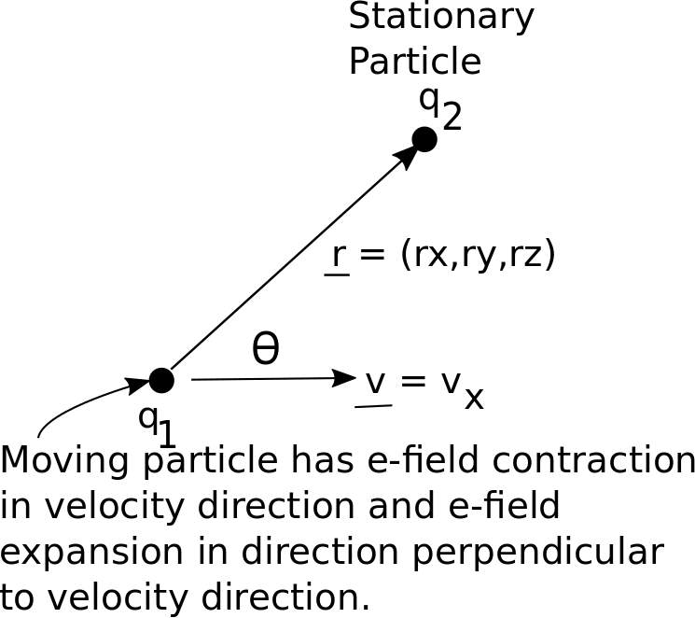
Theta is the angle between the Position Vector r and the velocity vector v

Slide 16
Length Contraction, Expansion of e-field of a moving Charged Particle as seen by a Stationary Particle

Slide 17
Magnetic Force Between Relative Slow Moving Isolated Charges
Using the Binomial Theorem and eliminating higher orders of on Eq. (4), the total electric field force and magnetic force between the relative slow moving charges appears:
(5)
Subtracting the electric field force from (5) we have the magnetic force:
(6)

Slide 18
The Magnetic Force Law Between a Stationary Charge and a Stationary Current Element
Include one more relativistic effect, , in the numerator of Eq. (4) for current elements. This effect is length contraction of the spacing between the moving electrons in the current element. This increases the charge density of the moving electrons in the current element as seen by a stationary charge. The resulting magnetic force law is:
(7)
Where is the line charge density.
Note: This is the equation employed 3 times to arrive at Andre Ampère’s Law.

Slide 19
Vector diagram for determining relative velocity vector between two velocity vectors and also the cos(Ɵ) term of Eq. (7). This is a very important diagram used for deriving Andre Ampère’s Law.

Slide 20
Perform the following mathematical steps to determine the and the relative velocity of the electrons v_{R} in Eq. (7) for the two current elements:
Law of Cosines
So
Where
Also
So

Slide 21
Adding the Magnetic Forces Between Current Elements to Arrive at Andre Ampère’s Law
e₁---electron lattice in current element 1
p₁---proton lattice in current element 1
e₂---electron lattice in current element 2
p₂---proton lattice in current element 2
F(magnetic)→ (e₁—p₂) + (e₁—e₂) + (e₂—p₁)
Notes:
(p₁—p₂) + (e₁—e₂) static coulomb electric repulsive relationships is zeroed out by the (e₁—p₂) + (e₂—p₁) static coulomb electric attractive relationships. These have no magnet force.
2. The (e₁—e₂) magnetic force relationship needs to use the math associated with the relative velocity between two moving objects as shown in the above two slides.
3. The charges in (7) are replaced by Ids/v’s resulting in the Old Ampere’s Law. These “v’s” are associated with the electron velocities in the current elements.

Slide 22
Summary
Magnetic Forces Between: (Free space)
With k = $\frac{1}{4π∈_{o}}$ = $\frac{μ_{o}c^{2}}{4π}$
Slow relative moving particles:
A stationary charged particle and a current element:
Two current elements: (Andre Ampère’s Law)
Notes:
Notes:
1. Checked for formula updates 10/7/22. JK

Slide 23
Concluding Remarks
These are powerful equations
Do not violate Newton’s 3rd Law
Allow computer calculations of physical properties on an element basis instead of having to integrate around a loop
Can be used to determine induction and create a field of study what I call Einsteinian Electrodynamics
Can be use to calculate forces between atoms
Can be applied to radio signal propagation

Slide 24
Other Applications
This equation is extremely powerful
Can be applied in an analogous manner to a gravity field in cosmology
Can be applied to particle physics

Slide 25
Acknowledgement
Late Dr. Wolfgang Rindler who wrote the book: Essential Relativity, Special, General, and Cosmological, and who was my instructor in a relativity class in 1980.
Dr. Charles Adams who is a current friend and who gave me some suggestions in making this presentation better.

